Slide 1

Knuth–Morris–Pratt (KMP) Algorithm for DNA Pattern Matching
STARK DNA Pattern Matching Project
November 2025
Abstract
This report provides an overview of the Knuth–Morris–Pratt (KMP) algorithm for efficient and accurate DNA pattern matching. It explores how KMP quickly identifies specific sequences within genomic data, detailing its search process, effectiveness, and real-world performance. The findings and implementation align with the documentation standards established for other algorithms in this repository.

Slide 2
1 Introduction
String matching is a fundamental task in bioinformatics. It helps us find specific sequences within genetic information.
The Knuth–Morris–Pratt (KMP) algorithm is used for this purpose. It efficiently finds a shorter DNA sequence (the "pattern") inside a longer one (the "text").
Key applications of string matching include:
Searching for specific DNA motifs
Validating primers for experiments
Annotating parts of a genome
Why KMP is well-suited for DNA:
DNA is made of a simple alphabet (A, C, G, T).
KMP offers consistently fast performance.
It requires minimal memory to operate.
1.1 Problem Statement
Input
Output
Text T (a DNA sequence), pattern P (a shorter DNA sequence).
All starting points where pattern P is found within text T.

Slide 3
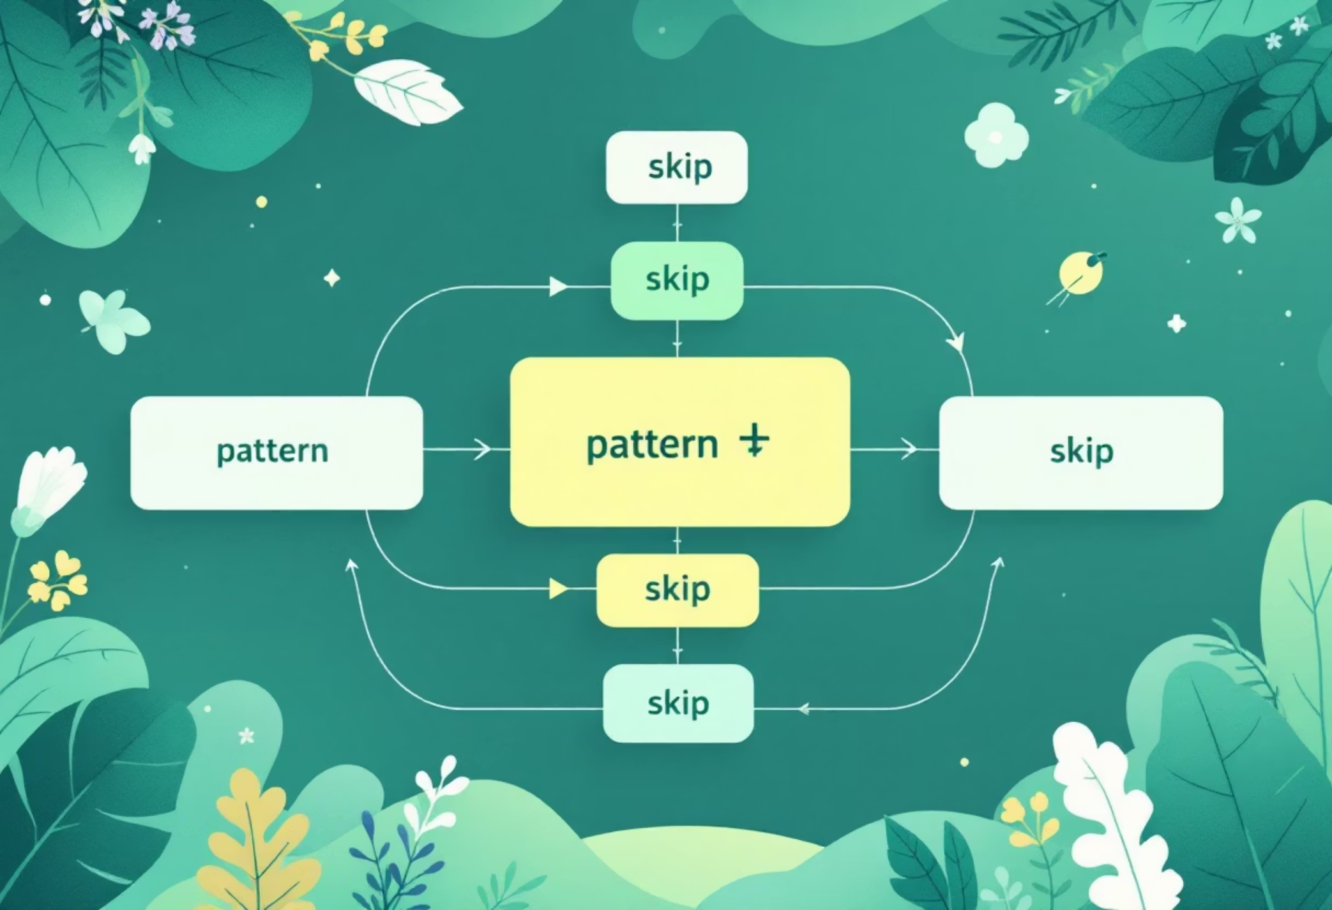
2 Algorithm Description
KMP quickly finds patterns by intelligently avoiding repeated checks.
The KMP algorithm first "learns" the internal structure of the pattern it's searching for. This intelligence allows it to make smart jumps when a mismatch occurs. Instead of starting the comparison from scratch, KMP knows exactly how far to shift the pattern forward, ensuring it never re-examines characters in the main text that have already been checked.

Slide 4

2.1 LPS (Failure Function)
Key Concept: Think of the LPS array (Longest Proper Prefix which is also a Suffix) as a "smart lookup table." For every position in your search pattern, it tells the KMP algorithm how far to intelligently shift the pattern forward if a mismatch occurs. This table is built efficiently before the main search begins.
01
02
Build the Smart Lookup Table
Start Simple
We create a special array, the LPS array, which acts like a guidebook for our search pattern, noting its internal repeating parts.
The first entry in our lookup table is always 0, as a single character doesn't have any repeating prefix-suffix patterns.
03
04
Learn the Pattern's Secrets
Quick Setup
As we go through the pattern, we fill in this table. It learns, for each point, the longest section that acts as both a beginning and an end of the pattern up to that point. This tells us exactly where to jump to next.
Building this smart lookup table is very fast, taking time proportional to the length of the pattern itself (O(m) complexity).

Slide 5




2.2 Search Procedure
Now that we have our "smart lookup table" (LPS array), we begin searching. We go through the main text, comparing characters. When we find a match, we keep going. If there's a mismatch, the LPS table tells us exactly where to jump in our pattern, so we don't have to start all over again. This saves a lot of time!
Scan the Text
Compare Characters
Read the main text character by character.
Match text characters with the pattern.
Efficient Skip
Find a Match!
If no match, use the LPS table to jump ahead.
Report the location where the pattern is found.

Slide 6
3 Complexity Analysis
Preprocessing (LPS)
Search
Total Complexity
Time: O(m)
Time: O(n) worst case
Time: O(n + m)
Space: O(m)
Space: O(1) extra beyond LPS
Space: O(m)

Slide 7
4 Proof of Correctness
The Knuth-Morris-Pratt (KMP) algorithm works correctly and efficiently because it cleverly avoids wasting time on redundant comparisons. Here's a simplified breakdown:
How KMP Ensures Correctness:
When KMP finds a mismatch between the text and the pattern, it doesn't just start the pattern search from scratch at the next character in the text.
Instead, it uses a pre-calculated "failure function" (often called the Longest Proper Prefix that is also a Suffix, or LPS array) to figure out how much of the pattern has *already* matched a suffix of the text examined so far.
This means it can shift the pattern forward to a position where a known prefix of the pattern aligns with a suffix of the previously matched text segment. This smart shift guarantees that no potential matches are missed.
Essentially, it "knows" where to continue looking in the pattern without ever having to re-examine characters in the main text that it has already processed.
How KMP Ensures Efficiency:
The key to KMP's efficiency is that the text pointer (index `i`) never moves backward. It only ever moves forward.
When a mismatch occurs, only the pattern pointer (index `j`) is reset based on the LPS array. This operation takes constant time.
Because both the text pointer and the pattern pointer (in total) only advance through their respective strings at most once, the algorithm completes its search in a time proportional to the sum of the lengths of the text (n) and the pattern (m). This makes it significantly faster than simpler string searching methods in worst-case scenarios.

Slide 8
5 Pseudocode
This first algorithm, ComputeLPS, is a helper function that builds the "Longest Proper Prefix that is also a Suffix" (LPS) array for the search pattern. This array tells the main KMP search algorithm how many characters to shift the pattern when a mismatch occurs, without losing potential matches.
This second algorithm, KMP-Search, uses the LPS array (computed by the first algorithm) to efficiently find all occurrences of pattern `P` within text `T`. It avoids re-checking characters that have already been matched, making it very fast.
5.1 LPS Computation
5.2 Search
Algorithm 1 ComputeLPS(P)
Algorithm 2 KMP-Search(T, P)
1: m ← |P|, LPS[0] ← 0, len ← 0 // Get pattern length (m), initialize LPS array (first element always 0), and a variable 'len' to track length of current matching prefix/suffix2: for i ← 1 to m − 1 do // Loop through the pattern 'P' from the second character (index 1) to the end3: while len > 0 and P[i] ̸= P[len] do // If we have a current match length ('len' > 0) but current characters P[i] and P[len] don't match4: len ← LPS[len − 1] // 'len' is reduced by looking at the LPS value of the previous character. This is like "backtracking" in the pattern.5: end while // End of while loop6: if P[i] = P[len] then // If the current characters P[i] and P[len] match7: len ← len + 1 // Increase 'len' as we found a longer matching prefix/suffix8: LPS[i] ← len // Store the new 'len' in LPS array for the current index 'i'9: else // If characters don't match and 'len' was 0 (no current prefix/suffix match)10: LPS[i] ← 0 // Set LPS value for current index 'i' to 011: end if // End of if statement12: end for // End of for loop13: return LPS // Return the computed LPS array
1: n ← |T|, m ← |P|, LPS ← ComputeLPS(P) // Get lengths of text (n) and pattern (m), then compute the LPS array for P2: i ← 0, j ← 0, matches ← [ ] // Initialize text pointer (i), pattern pointer (j), and an empty list to store match starting positions3: while i < n do // Loop while the text pointer 'i' hasn't reached the end of the text 'T'4: if T[i] = P[j] then // If the characters at the current text and pattern pointers match5: i ← i + 1 // Advance text pointer6: j ← j + 1 // Advance pattern pointer7: if j = m then // If the entire pattern 'P' has been matched (j equals pattern length 'm')8: matches.append(i − j) // Add the starting index of the match (current text pointer - pattern length) to the list9: j ← LPS[m − 1] // Reset pattern pointer 'j' using the LPS array to prepare for finding the next potential match10: end if // End of inner if statement11: else if j > 0 then // If characters didn't match, AND the pattern pointer 'j' is not at the beginning (meaning we had some previous matches)12: j ← LPS[j − 1] // Reset pattern pointer 'j' using the LPS array to shift the pattern correctly13: else // If characters didn't match, AND the pattern pointer 'j' is at the beginning (no previous matches)14: i ← i + 1 // Just advance the text pointer 'i' and try matching from the beginning of the pattern again15: end if // End of if statement16: end while // End of while loop17: return matches // Return the list of all found match starting positions

Slide 9
6 Edge Cases
Empty Pattern (m=0)
Pattern Longer Than Text (m > n)
An empty pattern is considered invalid and will not be processed.
If the pattern is longer than the text being searched, no matches are possible.
Highly Repetitive Patterns
Overlapping Matches
Even with patterns like "AAAA", KMP maintains its efficiency because of how the LPS array handles pattern shifts.
The algorithm correctly identifies and accounts for all overlapping occurrences of the pattern within the text.
7 Implementation Overview
Our KMP algorithm is implemented in Python (see kmp.py). It's designed as a flexible tool that allows users to easily find all occurrences of a pattern, locate the first match, count total matches, or even search for multiple patterns simultaneously. The system also automatically standardizes text input (e.g., converts to uppercase) and optimizes performance by preparing the search pattern just once for each search task.

Slide 10
8 Experimental Setup
Our evaluation uses two types of DNA data: synthetic sequences (random combinations of A, C, G, T) and real genome data from NCBI. We performed several benchmarks to test KMP's performance:
How pattern length affects speed (with a fixed text size).
How text length affects speed (with a fixed pattern length).
Searching for multiple patterns within the same text.
Running KMP on various FASTA genome files.
All benchmark results are saved in JSON format (e.g., KMP/benchmark results.json).
9 Results
9.1 Synthetic Sequences
When searching through synthetic DNA sequences ranging from 10,000 to 1,000,000 characters, and using patterns between 20-100 characters long, KMP showed consistent performance. The total search time increased directly with the length of the text, confirming its efficient linear-time (O(n)) behavior.
9.2 Real Genomes
On real bacterial genomes (typically 4-6 million base pairs), KMP processed the sequences very quickly, reaching speeds of tens of megabytes per second (Mbp/s) on a standard laptop CPU. This demonstrates its linear-time efficiency even with complex biological data.
Metric
Min
Median
Mean
Max
Speed (Mbp/s)
–
–
–
–
Time (ms)
–
–
–
–
Table 1: Summary placeholder; see notebook for concrete numbers.
10 Discussion
KMP provides predictable linear-time behavior independent of pattern content, in contrast to Boyer–Moore which benefits from larger shifts on average. For DNA alphabets, KMP is robust and memory-light, making it a great baseline for exact matching.
11 Conclusion and Future Work
KMP achieves O(n + m) performance for exact DNA pattern matching with minimal memory overhead. Future work includes: multi-pattern automata (Aho–Corasick), approximate matching, SIMD acceleration, and parallelization.
Reproducibility
Code: KMP/kmp.py, benchmarks in KMP/benchmark.py, notebook KMP/kmp nb.ipynb.
Datasets: DnA dataset/ncbi dataset/data.
Environment: see KMP/requirements.txt.
References
Knuth, D. E.; Morris, J. H.; Pratt, V. R. (1977). "Fast pattern matching in strings." SIAM Journal of Computing 6(2): 323–350.
Gusfield, D. (1997). Algorithms on Strings, Trees, and Sequences. Cambridge University Press.
GeeksforGeeks. KMP Algorithm for Pattern Searching. https://www.geeksforgeeks.org/kmp-algorithm-for-pattern-searching/
NCBI Datasets. https://www.ncbi.nlm.nih.gov/datasets

